Slide 1

WEB-D Presentation
Made by:-
Ayush Gupta
CS-B
2428CS2243
202401100100079

Slide 2

E-Commerce: Building a Successful Online Presence
This presentation explores key strategies for building a thriving e-commerce business.

Slide 3
The Rise of E-Commerce
Convenience
Accessibility
Cost-Effectiveness
Global Reach
Shoppers appreciate the ease of online shopping, from the comfort of their homes.
Online stores provide access to a wider range of products and services.
E-commerce often offers competitive pricing and discounts.
Online businesses can connect with customers worldwide.

Slide 4

Understanding Your Target Audience
Demographics
Psychographics
Identify age, location, income, and interests.
Understand values, beliefs, and lifestyle preferences.
Buying Behavior
Customer Feedback
Analyze past purchases and online browsing activity.
Gather insights from surveys, reviews, and social media.

Slide 5
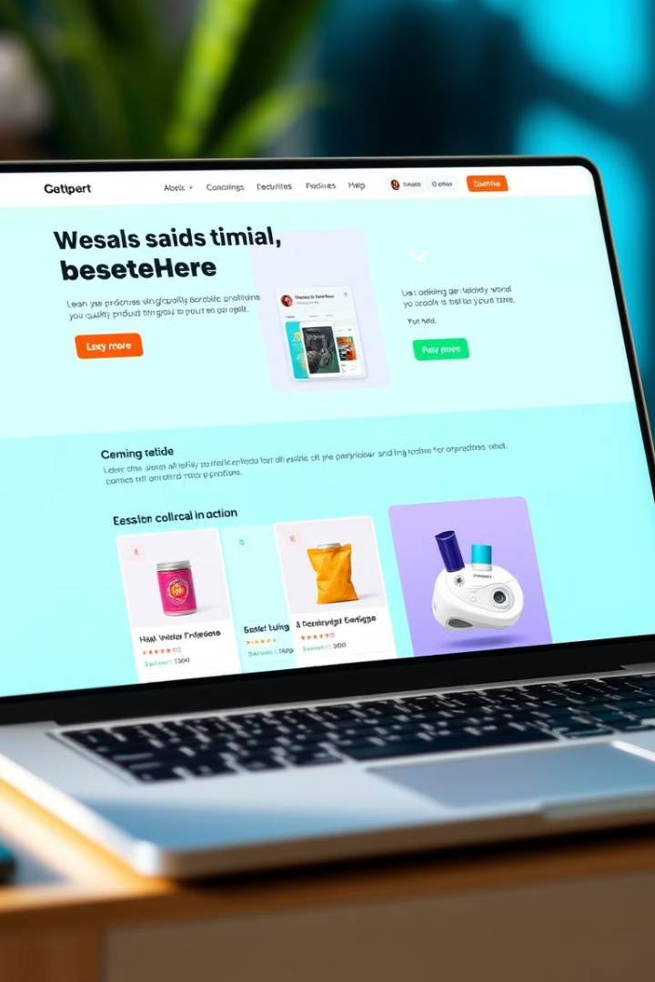
Creating an Engaging Website Design
User-Friendly Navigation
Compelling Product Images
Make it easy for customers to find what they're looking for.
Showcase products in a visually appealing and informative way.
Clear Calls to Action
Mobile Optimization
Guide customers towards completing a purchase.
Ensure a seamless experience on all devices.

Slide 6
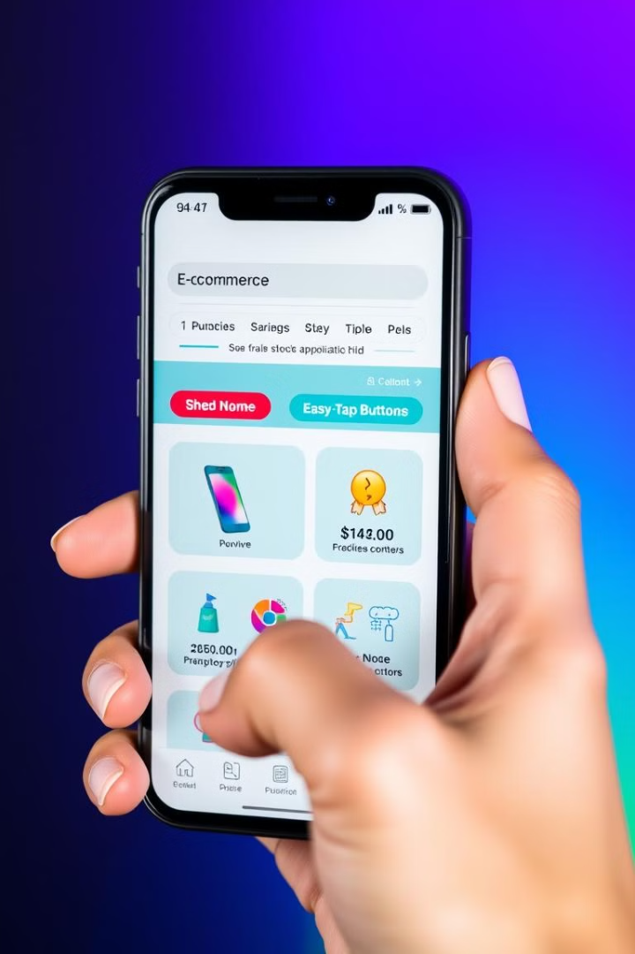




Optimizing for Mobile-First Experiences
Responsive Design
Page Loading Speed
Website adapts automatically to different screen sizes.
Minimize wait times for optimal user experience.
Touch-Friendly Navigation
Mobile Checkout Optimization
Large buttons and easy-to-tap elements enhance usability.
Streamline the checkout process for mobile users.

Slide 7

Streamlining the Checkout Process
1
Secure Payment Options
Offer popular and trusted payment gateways.
2
Guest Checkout
Allow customers to purchase without creating an account.
3
Clear Shipping Information
Provide detailed shipping rates and delivery estimates.
4
Order Tracking
Enable customers to track their orders in real-time.

Slide 8





Implementing Effective Marketing Strategies
Content Marketing
1
Create valuable and engaging content to attract customers.
Search Engine Optimization (SEO)
2
Improve website visibility in search results.
Social Media Marketing
3
Engage with customers and build brand awareness.
Email Marketing
4
Send targeted promotions and updates to subscribers.
Paid Advertising
5
Reach a wider audience through targeted online ads.

Slide 9

Leveraging Data and Analytics
100%
50%
Conversion Rate
Customer Retention
Track the percentage of website visitors who make a purchase.
Measure the rate at which customers make repeat purchases.
$1M
10k
Average Order Value (AOV)
Customer Lifetime Value (CLTV)
Analyze the average amount spent per purchase.
Estimate the total revenue generated from each customer over time.

Slide 10
Providing Exceptional Customer Service
Responsive Communication
1
Respond to inquiries promptly and efficiently.
Personalized Assistance
2
Provide tailored solutions to meet customer needs.
Problem Resolution
3
Address issues quickly and effectively.
Customer Feedback
4
Gather insights to improve service offerings.

Slide 11


